Slide 1
Out Put document

Slide 2
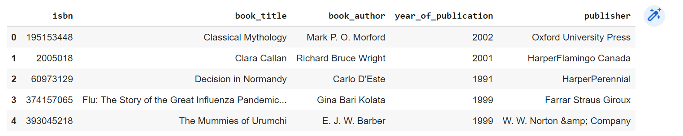

Read the books dataset and explore it

Slide 3
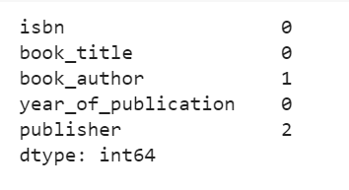
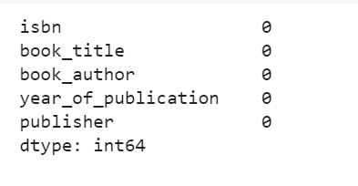
Clean up NaN values
Before cleaning NaN values:
After cleaning NaN values:

Slide 4
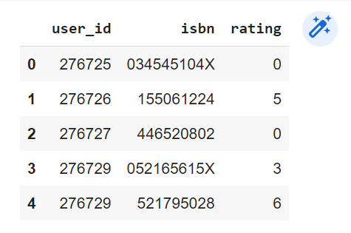
Read the data where ratings are given by users

Slide 5
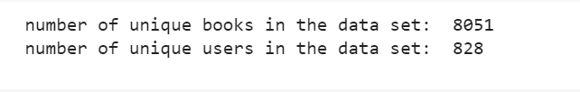
Take a quick look at the number of unique users and books

Slide 6
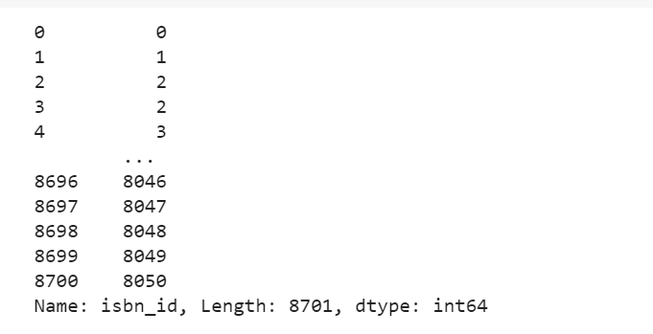
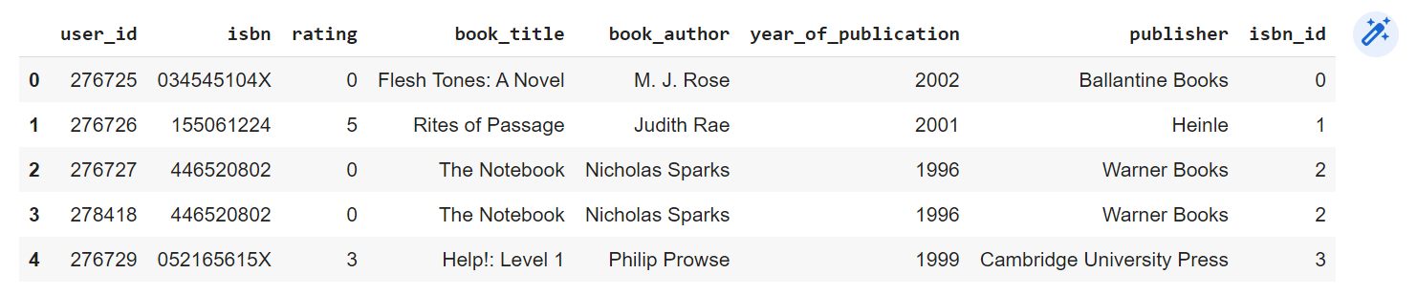
Convert ISBN variables to numeric numbers in the correct order

Slide 7
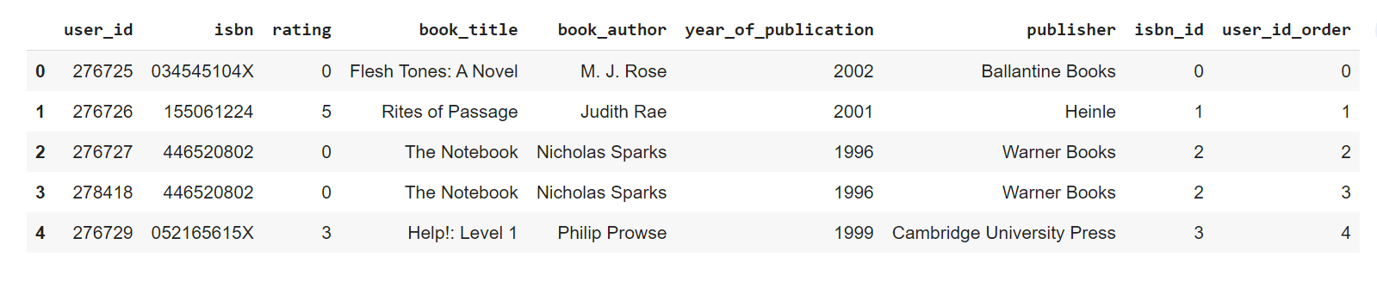
Convert the user_id variable to numeric numbers in the correct order

Slide 8
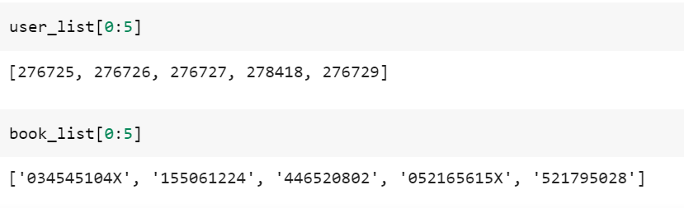
Convert both user_id and ISBN to the ordered list, i.e., from 0...n-1

Slide 9
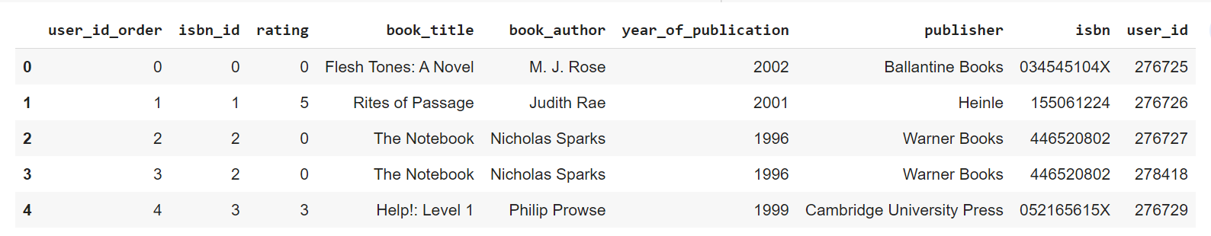
Re-index the columns to build a matrix

Slide 10
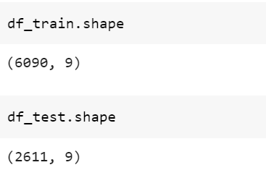
Split your data into two sets (training and testing)

Slide 11
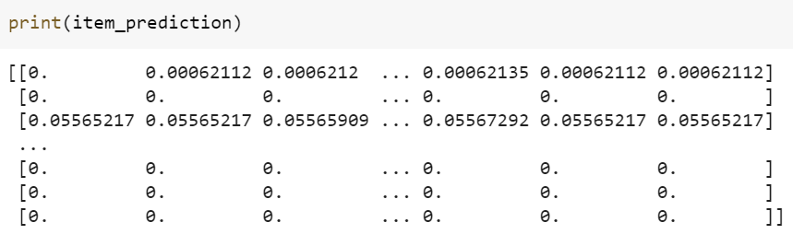
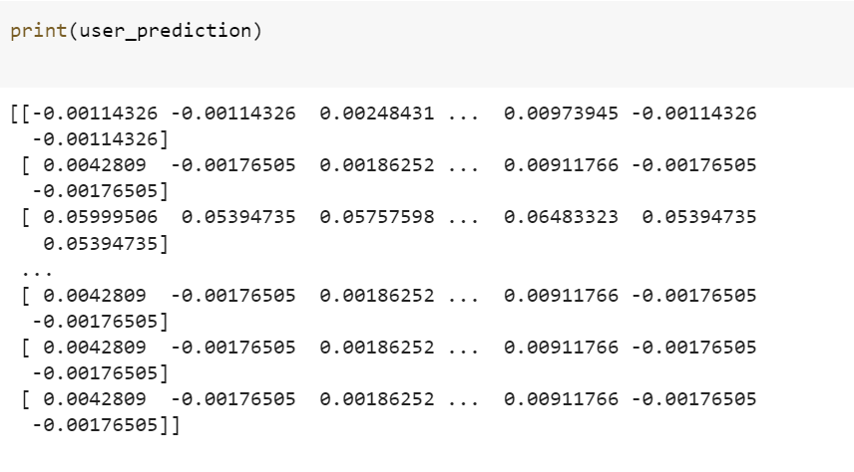
Make predictions based on user and item variables

Slide 12

Use RMSE to evaluate the predictions

